Slide 1
Based Block chain 2.0 (Ethereum)
My Digi Money
(MDM donation system)
졸업작품2 | 안연선, 이예지, 이종현, 홍진형
지도교수 | 민연아 교수님

Slide 2
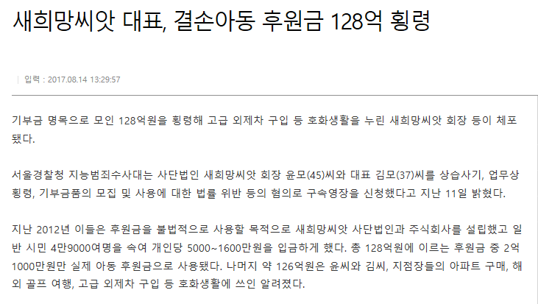


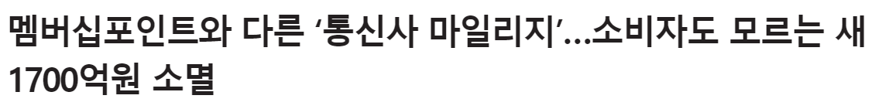
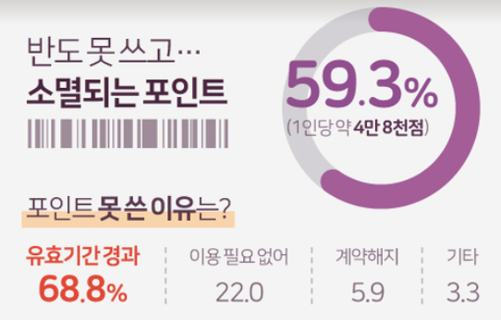

Motivation
Problem of donation’s embezzlement
Donator’s Doubt
Discarded & unrecognized point
68% of donors said.
They want to know
the usage route and process
of their donation
68 %
[reference] NEWS JELLY
Un-transparent donation
problems continued
Decrease in trust in charities
since they are not sure
how their donations are spent
A fall in Confidence
Most of the points are disappearing without being noticed

Slide 3



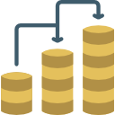

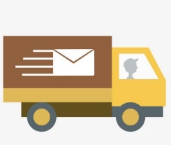
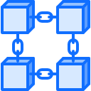
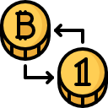





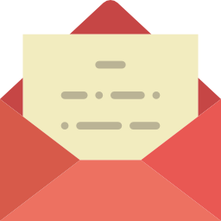
Project
My Digi Money
(MDM donation system)
Specification
Check the points & cyber money
1. Send to donate them directly
2. Exchange them to “MDM Money“
MDM donation system
Unrecognized money can help beneficiary
Expected Effect1
Expected Effect2
Promote donation activities with transparent donation status disclosure
Utilize unrecognized points
in meaningful places

Slide 4

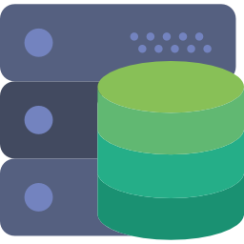
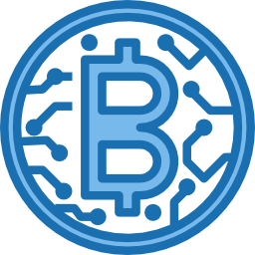
Progress
Sequence of operate (about 3 steps)
Platform configuration
(Based on Web page)
1
Can create and store user account on server DB.
and can find and store user’s digital point.
Also, can manage web server.
Can create lightwallet address
and show own’s address and seed of it.
Then, Using web page UI , possible to donation.
Construct Server
(Back-end role)
3
Construct BlockChain
(Based on Solidity)
2

Slide 5
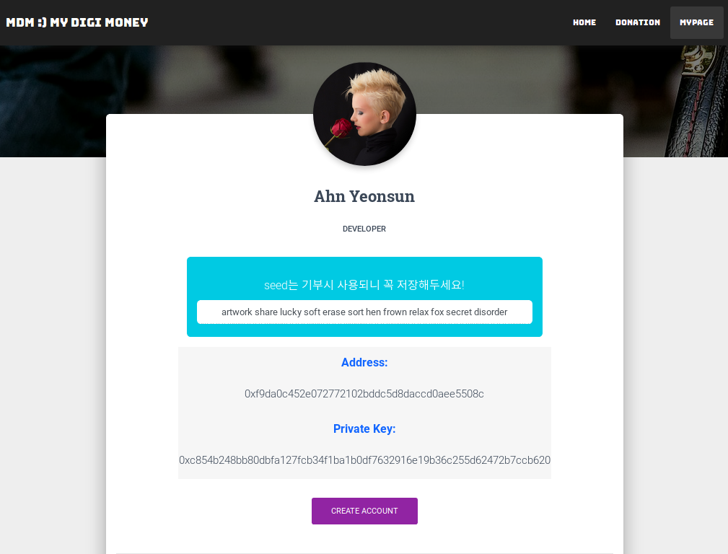
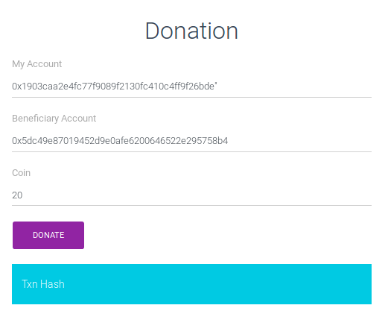

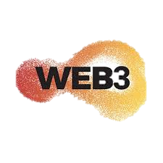


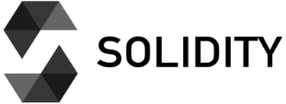


Progress
1
Donation Process(1)
my: 2115 mdm
After write send and beneficiary address
and coins,
then show
Transaction Hash
beneficiary: 10 mdm
Seed
donate 20 mdm
Ethereum address
Private Key
Create Account
Donate
mypage.html
transaction.html
Front-end
Back-end

Slide 6
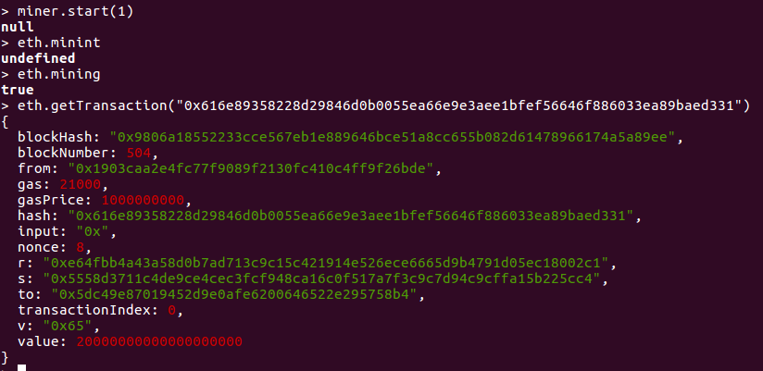
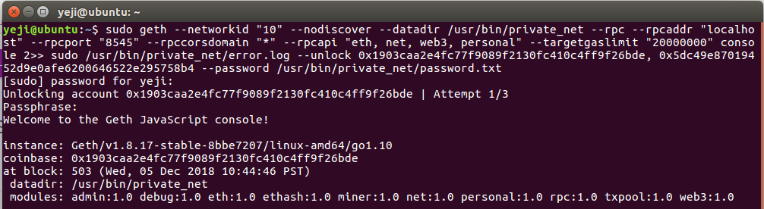

Progress
success donation!
1
Donation Process(2)
after donation
Transaction Hash
operation condition
Operation condition
(1) executing geth
success transaction
(2) executing node app.js (web server)
eth.getTransaction()

Slide 7
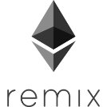
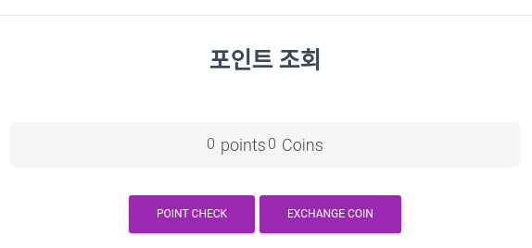
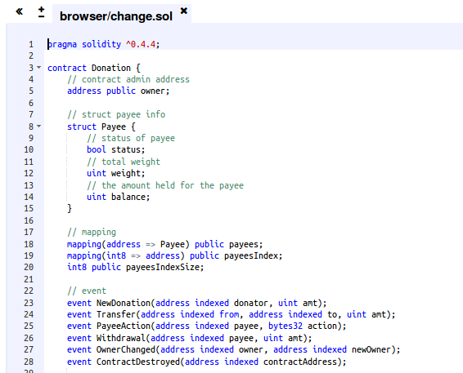
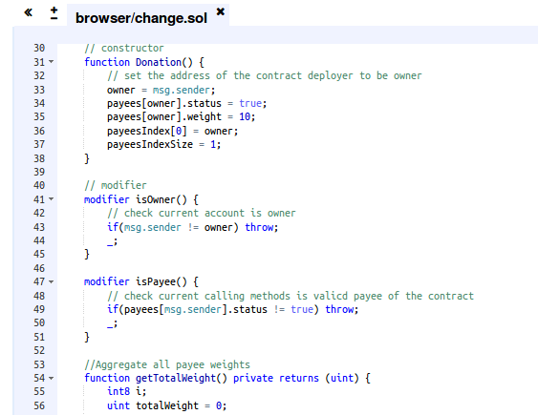
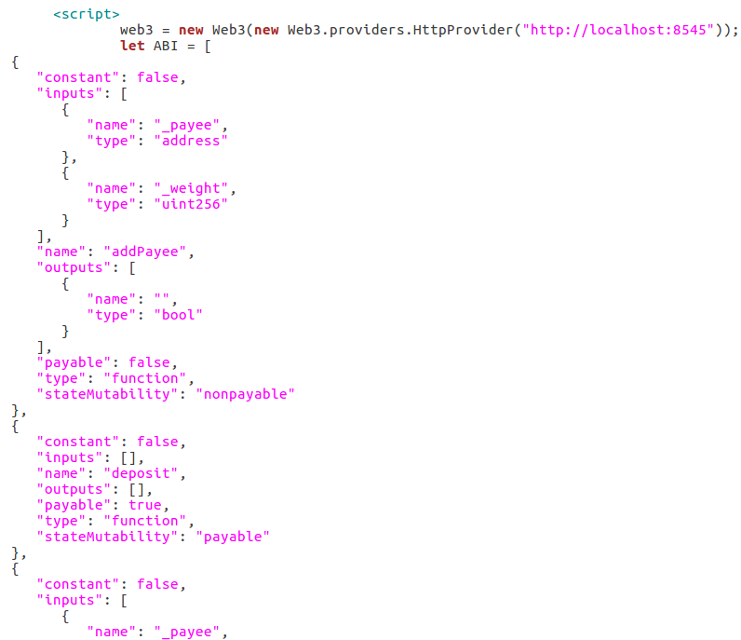
Progress
2
Smart Contract process
Implementation
using Smart Contract
Deploy contract
using Remix
Complete ABI code
using Web3 provider

Slide 8
Marketing plan
operation condition
Contents marketing
1
: It attracts consumers' attention by continuously creating content(ex.blog, facebook) about our donation function. The marketing effect can set up the target customer and recognize the brand value to the customer.
Viral marketing
2
: When a certain amount of customers are gathered, the company continuously promotes the product based on the user's experience through viral marketing..

